Slide 1
Chapter 01 Linux and Windows Server
Session 01
Different between
Linux and Windows Server

Slide 2


OBJECTIVES FOR TODAY
Explain how different between Linux and Windows
Understanding how Linux command line works
Be a able to use some basic command line on Linux CLI

Slide 3



What is …?
ENGAGE
2 MIN
Operating System
Server
OS Family
Microsoft
Notes:
Life without internet would be like:
No internet-communication (e-mail, messenger, social media ...)
Effect on Business (online store, e-commerce, making money online …)
Access to information & resource cut (education, entertainment…)

Slide 4
Operating System History

Slide 5
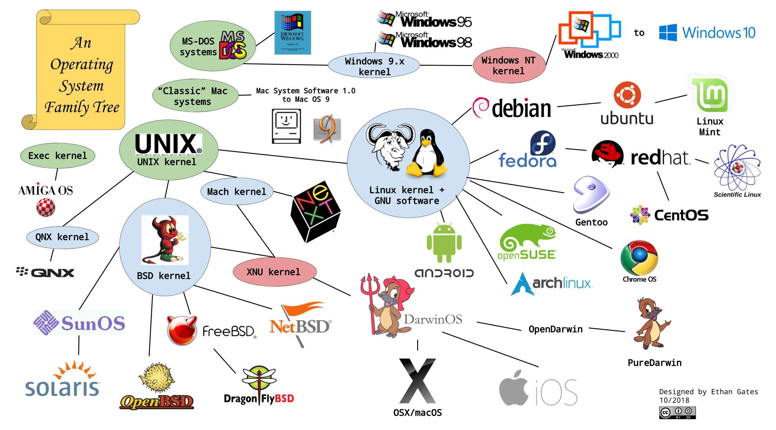
OS Families
Notes:
https://www.pcmag.com/news/a-visual-history-of-windows
- The first Operating system called “UNIX” was developed by Ken Thomson and Dennis Ritchie of AT&T Bell laboratories in 1969 and 1st release in 1970.

Slide 6


EXPLAIN
Microsoft Windows History
5 MIN
Microsoft Corporation founded by Bill Gates and Paul Allen in 1975.
Introduced Windows in 1985 to challenge Apple’s GUI
Windows with GUI went to public in 1986
1993 – Microsoft introduce Windows NT

Slide 7

EXPLAIN
Linux History
5 MIN
Linux is a modern, free open source operating system based on UNIX standard.
Linux kernel 0.01 was created (as small self-project) in 1991.
Linux Kernel 1.0 was release in 1994.
Linux quickly started to be used as the kernel for free software operating system.
Linus Torvalds

Slide 8
LINUX vs WINDOWS

Slide 9

VS

Slide 10
EXPLAIN
What is Linux?
5 MIN
Free and Open source Operating System
High Security
Multi-tasking OS
Multi-user OS
Support old devices
Require less hardware resources
Provide both GUI and CLI
Community support

Slide 11

EXPLAIN
Linux Server licences
5 MIN
Linux Operating system are created under the model of Free and Open Source Software (FOSS)
However, Linux OS also have the commercial platform:
Red Hat Enterprise Linux (RHEL)
SUSE Linux Enterprise Server (SLES)
Ubuntu Desktop for Enterprise
Oracle Linux
Etc.

Slide 12
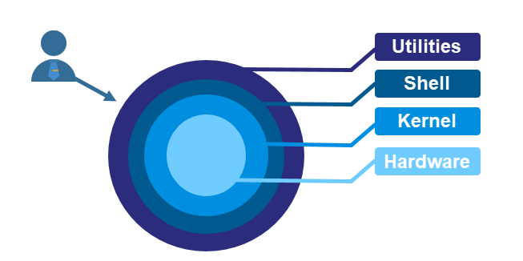
EXPLAIN
Linux Architecture
5 MIN
In Linux architecture consist of main components such as:
Kernel
Shell
System Utilities
Hardware layer

Slide 13
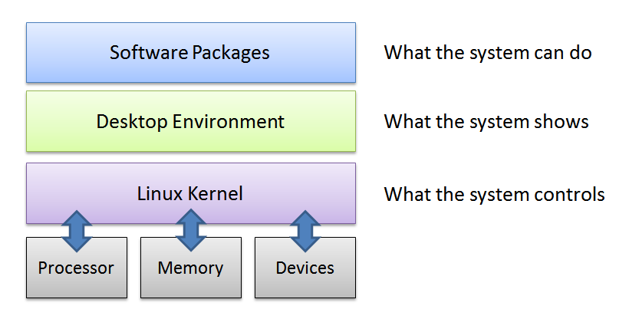
EXPLAIN
Linux Architecture
5 MIN
Kernel – is a core component of operating system that have control over everything on system. It’s communicate between user applications and hardware.

Slide 14
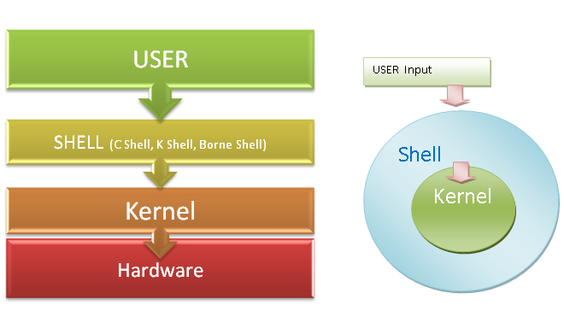
EXPLAIN
Linux Architecture
5 MIN
Shell – is a program that acts as the interface between user and Linux kernel, allowing you to enter commands (input) for operating system to execute.
There are many shell programs exist:
SH : Borne Shell
BASH : Bourne Again Shell
CSH : C Shell
TCSH : TC Shell
KSH : Korn Shell
ZSH : Zsh Shell

Slide 15
EXPLAIN
The different between Linux and Windows environment
5 MIN
 | Linux | Windows
Usage | Mostly used by technical people Used in major system administration, code developer | Mainly used by individual with no IT knowledge, for daily work, business, and other general use.
License type | Linux under open source It is designed to provide freely access under GNU GPL license | Close source operating system It licensed under Microsoft company
Source code | There is full access to source code | There is no access to source code

Slide 16
EXPLAIN
The different between Linux and Windows environment
5 MIN
 | Linux | Windows
Price | Most Linux distributions are free of charge | Windows OS has many different version and pricing options
User Friendly | Using a Linux system required technical skill | Designed to be simple use for users with limited technical skill
Command Line Interface (CLI) | CLI is very useful tool for administration and daily tasks | Windows users access CLI by entering CMD in the Run, but user don’t commonly use it.
Security | More secure 60-100 virus listed | Less secure 60,000 virus listed

Slide 17
Linux Directory Structure

Slide 18
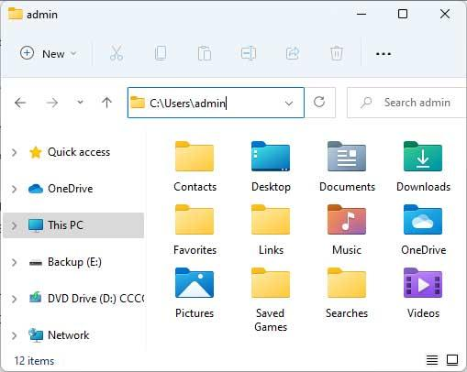

EXPLORE
Explore your folder structure on Windows
5 MIN

Slide 19

EXPLAIN
Directory vs Folder
5 MIN
LINUX USERS
WINDOWS USERS
Directory
Folder
Notes:
- https://edu.gcfglobal.org/en/internetbasics/what-is-the-internet/1/#

Slide 20
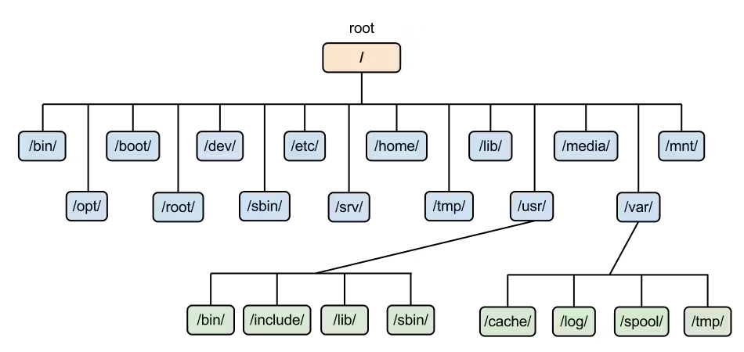
EXPLAIN
Linux Directory Structure
5 MIN

Slide 21
Linux Command Line

Slide 22
ENGAGE
How to work on CLI?
2 MIN
What is command line?
How Linux command work?
Notes:
Life without internet would be like:
No internet-communication (e-mail, messenger, social media ...)
Effect on Business (online store, e-commerce, making money online …)
Access to information & resource cut (education, entertainment…)

Slide 23


EXPLAIN
GUI and CLI
5 MIN
Command Line Interface (CLI)
Graphical User Interface (GUI)
Takes text-based commands as input to perform computing tasks.
Takes point-and-click inputs through visual elements.

Slide 24

EXPLAIN
Command Line Structure
5 MIN
What is a Command?
Command is an instruction given by a user telling a computer to do something.
Command Syntax: command -[options] [arguments]
Command : Tell computer what to do
Option : Modify command’s behaviour.
Argument : Object for command to do with, can be files or other data.

Slide 25

EXPLAIN
Command Line Structure
5 MIN
There are two type of options:
Single character option usually preceded by –
Can be passed as –a-b-c or –acb,
Ex: # ls -l -a or # ls -la
Full-word option usually preceded by --
Ex: # ifconfig --help

Slide 26

EXPLAIN
Command Line Structure
Commands, options, and arguments are all case sensitive
Each items separated by a space
Some commands can be used without require any options or arguments. (ls , pwd…)
Sometimes there are more than one option and argument within a command line
Multiple commands can be separated by ;
256 characters can be entered on a single command line

Slide 27
Linux Command Prompt
EXPLAIN
What is command prompt?
Command prompt is the field in the terminal which is waiting for user to type commands. The command prompt provides some useful information to user.
[root@redhat8 /home] #
# represent as super user (root)
$ represent as normal user
Currently logged in username
System’s hostname
Current working directory

Slide 28


EXPLAIN
Linux Basic Commands

Slide 29
EXPLAIN
Linux Basic Commands
Working with file and directories
pwd : display the current working path of user
cd : change directory path
ls : lists contents in directory – ls [option] [file or dir]
cp : copy files and directory – cp [option] [file_name] [destination]
mv : move or rename files and directory
mv [option] [file_name] [destination]
mv [option] [old_name] [new_name]
touch : create an empty file
rm : remove file – rm [option] [file_name]
rm –rf [directory_name] used to remove directory
rmdir : remove an empty directory
mkdir : create directory

Slide 30
EXPLAIN
Linux Basic Commands
Text Editor and Text viewer
vim : the standard Linux text editor
less : view contents of file with one full screen at a time
cat : view contents of file
head : display the first 10 lines of a file
tail : display the last 10 line of a file
cut : print out the selected part of line from file to display on screen
grep : search or output lines matching with a given keyword from file

Slide 31
EXPLAIN
Linux Basic Commands
System performance checking
free : display a detailed report the system’s memory usage
top : used to show running processes on system
df : (disk-free) show available and used disk space on system
df –h shows in human-readable format
date : used to display or set the system date and time
history : show the last commands that have been recently used
hostnamectl : used to change hostname of the system

Slide 32
SSH Remote Access

Slide 33
What is …?
ENGAGE
2 MIN
Remote Control
IP
SSH
Protocol/Port
Notes:
Life without internet would be like:
No internet-communication (e-mail, messenger, social media ...)
Effect on Business (online store, e-commerce, making money online …)
Access to information & resource cut (education, entertainment…)

Slide 34
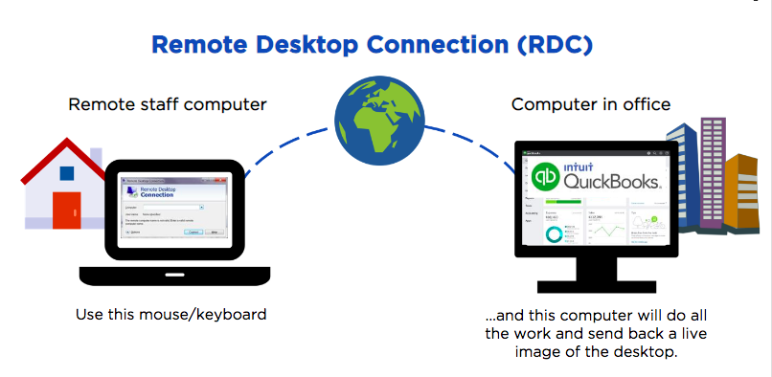
EXPLAIN
Remote Access
5 MIN
Remote access is the method to establish a connect over the server. It allows user to manage and view the system to work on server when it is not able to connect physically.

Slide 35
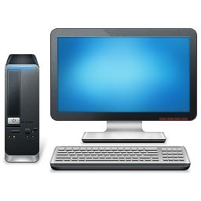

EXPLAIN
Type of Remote Protocol
5 MIN
Linux remote access using SSH protocol port TCP 22.
Windows remote access using RDP protocol port TCP 3389.

Slide 36
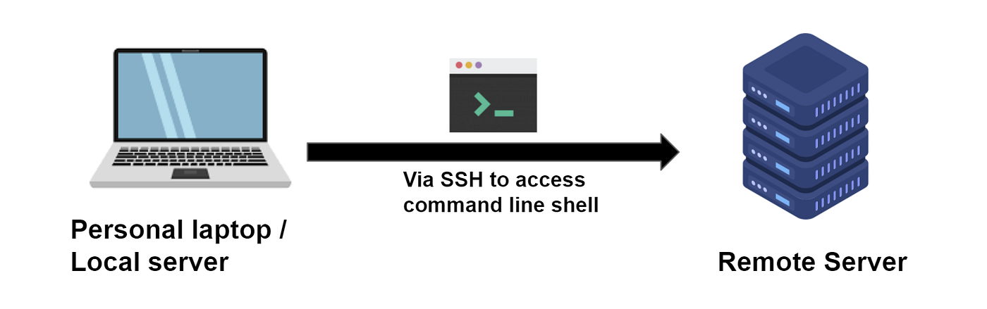
EXPLAIN
SSH Remote Introduction
5 MIN
The Secure Shell (SSH) protocol is a method for securely sending commands to a computer over an unsecured network.
SSH uses cryptography to authenticate and encrypt connections between devices.

Slide 37

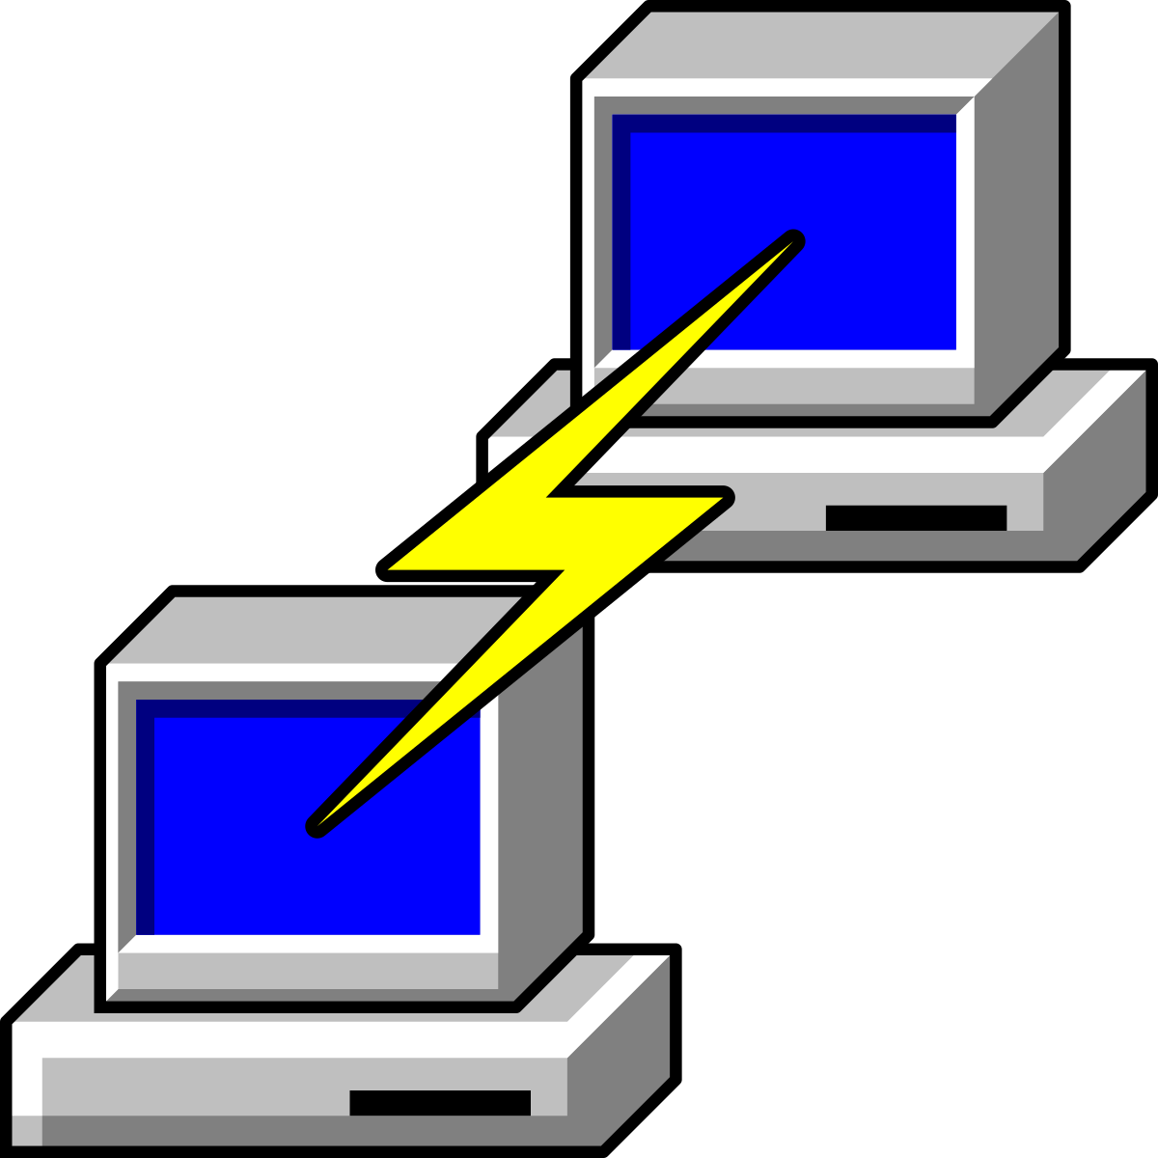



EXPLAIN
Remote Software Solution
5 MIN
WinSCP
Putty / Solar Putty
MobaXterm
mRemoteNG
SecureCRT

Slide 38

DEMO
Remote SSH to Ubuntu Server on Virtual Box using MobaXterm and Putty
5 MIN

Slide 39


